Slide 1
QLoRA-Enhanced Domain-Specific LLM Modeling for Hardware Trojan Detection
Capstone Project Phase 2
ESA Presentation
Notes:
1

Slide 2
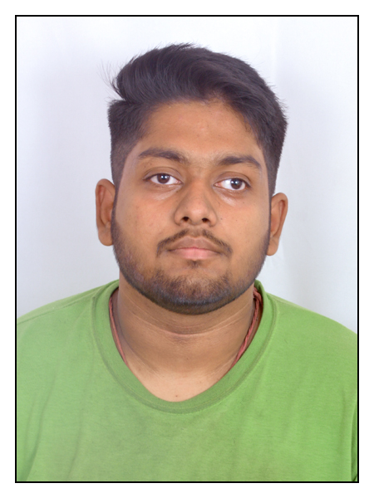
Sl.No. | Name | SRN | Photo
1 | DEBOPAM SINHA | PES1PG24EC006
Guide : Dr. NIRMALA DEVI M
Professor
Department of Electronics and Communication
2

Slide 3
Outline of Presentation
Introduction & Motivation
Objectives
Problem Statement
Methodology
Work Progress
Hardware / Software Implementation details
Results and Analysis
Project Deliverables
References
08-05-2026
Capstone Project M.Tech 2025-26 | Phase -2 | ESA
3

Slide 4
Introduction & Motivation
Global IC Supply Chain Risk : Outsourcing chip design and fabrication increases the chance of Hardware Trojans (HTs) from untrusted 3rd party sources.
Limits of Traditional Methods : Functional testing and side-channel analysis often miss stealthy attacks.
Challenges with Generic LLMs: Although large language models show promise in analyzing complex hardware patterns, fine-tuning them requires substantial computational resources, long training times, and high-end hardware, limiting their practical adoption.
Proposed Approach: This work proposes the development of a domain-specific LLM for hardware Trojan detection, leveraging QLoRA to enable efficient fine-tuning and deployment on consumer-grade hardware.
08-05-2026
Capstone Project M.Tech 2025-26 | Phase -2 | ESA
4
Notes:
4

Slide 5
Objectives
Efficient Model Adaptation: To adapt a pre-trained large language model into a domain-specific model for hardware Trojan detection using QLoRA, enabling efficient fine-tuning with reduced computational requirements.
Detection and Logic Coverage Analysis: To enable the model to detect Trojan components within a design and evaluate its precision using metrics such as Trigger Line Coverage (TLC) and Payload Line Coverage (PLC), ensuring interpretability of detection.
Robustness Against Obfuscation: To assess the model’s performance on obfuscated hardware designs, including modified signal names and injected Trojans, ensuring reliable detection under adversarial conditions.
Practical Deployment on Consumer Hardware: To demonstrate that the proposed approach can be trained and deployed on consumer-grade hardware, making advanced hardware security techniques more accessible and scalable.
08-05-2026
Capstone Project M.Tech 2025-26 | Phase -2 | ESA
5

Slide 6
Problem Statement
To develop a resource-efficient, domain-specific LLM framework using QLoRA that enables accurate and robust detection of hardware Trojans in complex and obfuscated circuit designs on consumer-grade hardware.
08-05-2026
Capstone Project M.Tech 2025-26 | Phase -2 | ESA
6

Slide 7
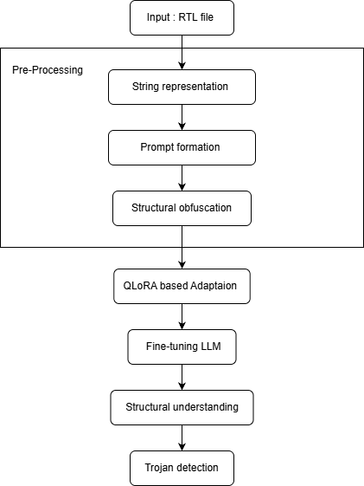
Proposed Methodology
08-05-2026
Capstone Project M.Tech 2025-26 | Phase -2 | ESA
7

Slide 8
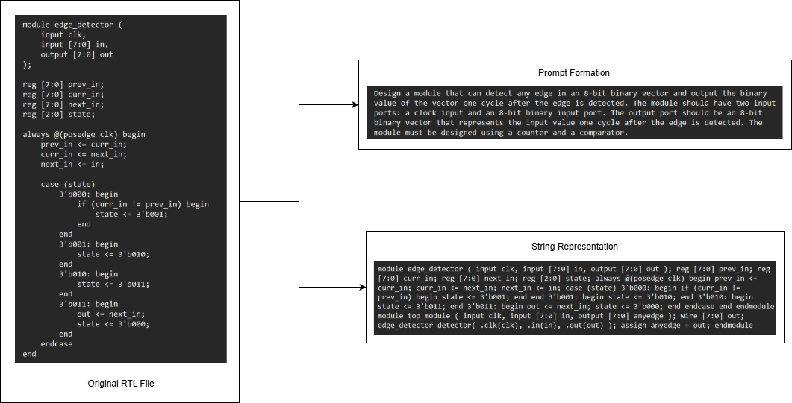
Implementation Details : Pre-Processing
08-05-2026
Capstone Project M.Tech 2025-26 | Phase -2 | ESA
8

Slide 9
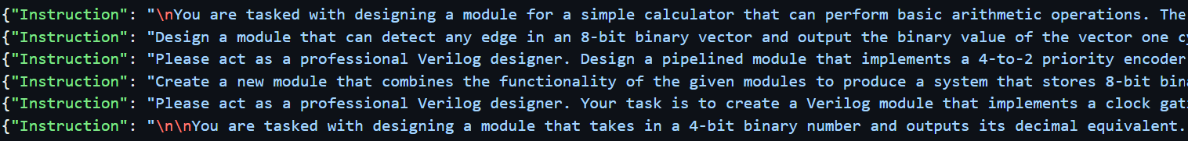
Pre - processed dataset
Obfuscation of Pre - processed dataset
08-05-2026
Capstone Project M.Tech 2025-26 | Phase -2 | ESA
9

Slide 10
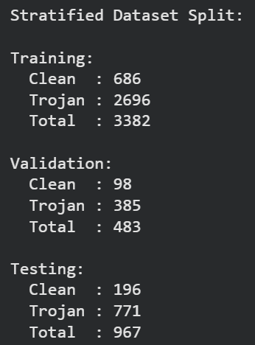
Stratified Dataset Split for Training, Validation and Testing
Dataset Overview : The dataset consists of 4,832 RTL samples (980 clean and 3,852 Trojan Infected Samples), including both clean and Trojan-infected designs, representing diverse structural patterns.
Stratified Data Splitting : The dataset is randomly divided into training, validation, and testing sets using stratified sampling to preserve the class distribution of clean and Trojan-infected samples across all splits.
Split Configuration : The data is split into 70% training, 10% validation, and 20% testing, ensuring sufficient data for learning, tuning, and unbiased evaluation.
Ensuring Robust Evaluation : Stratified splitting prevents class imbalance bias and ensures that performance metrics such as precision, recall, and localization accuracy (TLC/PLC) reflect real-world conditions.
08-05-2026
Capstone Project M.Tech 2025-26 | Phase -2 | ESA
10

Slide 11
Work Progress
Selected and prepared dataset consisting of clean and Trojan-infected RTL samples
Implemented structural obfuscation by renaming signals to node-based representations
Designed data pipeline including preprocessing, encoding, and prompt formulation
Integrated pre-trained LLM and set up QLoRA-based adaptation framework
Defined training strategy with stratified dataset splitting (train/validation/test)
Established evaluation metrics including detection accuracy, precision, recall, and F1-score
Caculated Trigger Line Coverage (TLC) and Payload Line Coverage (PLC) metrics
Completed the final Trojan Detection and Localization stage
08-05-2026
Capstone Project M.Tech 2025-26 | Phase -2 | ESA
12

Slide 12
Software Implementation Details
Programming Language: Python
ML Frameworks: PyTorch, CUDA Toolkit
Libraries: PEFT (QLoRA), Unsloth, scikit-learn
Hardware Description Processing: PyVerilog
Quantization & Optimization: bitsandbytes (NF4 4-bit quantization)
Datasets: Custom dataset built from TrustHub and ASIC Benchmarks websites
Development Environment: Google Colab
08-05-2026
Capstone Project M.Tech 2025-26 | Phase -2 | ESA
13

Slide 13
Results and Analysis
08-05-2026
Capstone Project M.Tech 2025-26 | Phase -2 | ESA
14

Slide 14
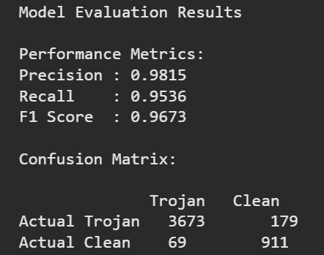
Performance Analysis of QLoRA enhanced LLM model
08-05-2026
Capstone Project M.Tech 2025-26 | Phase -2 | ESA
15

Slide 15
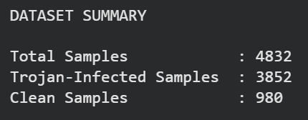
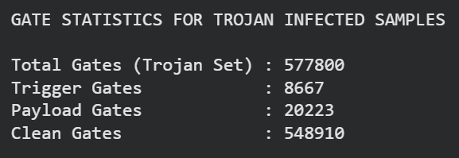
Computing TLC and PLC

Slide 16
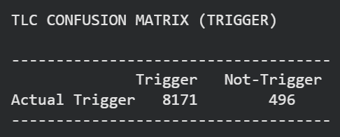

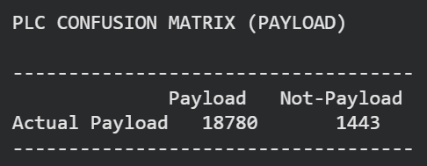

Trigger Line Coverage : Measures how many actual trigger gates are correctly identified.
Payload Line Coverage : Measures how many actual Paylaod gates are correctly identified.
08-05-2026
Capstone Project M.Tech 2025-26 | Phase -2 | ESA
16

Slide 17
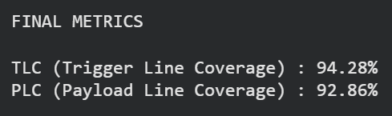
08-05-2026
Capstone Project M.Tech 2025-26 | Phase -2 | ESA
17

Slide 18
Efficiency Comparison
Baseline VS Propsed Approach
Metric | Baseline (Base Paper)
GPU Used | 4 NVIDIA RTX 3090 Ti
Model Setup | Full Fine-Tuning (LLaMA 3.1)
Dataset Size | 400 samples
Memory Usage | 945.1 MB
Training Time | 10,800 seconds (~3 hours)
Scaling Factor : 4832 / 400 = 12.08
08-05-2026
Capstone Project M.Tech 2025-26 | Phase -2 | ESA
18

Slide 19
Metric | Baseline (Base Paper) | Proposed (QLoRA-Based)
GPU Used | NVIDIA RTX 3090 Ti | NVIDIA T4 GPU
Model Setup | Full Fine-Tuning | QLoRA-Based Adaptation
Dataset Size | 400 samples | 400 samples
Peak GPU Memory Allocation | 945.1 MB | 380.9 MB
Training Time | 10,800 seconds (~3 hours) | 4327 Seconds (~1.2)
08-05-2026
Capstone Project M.Tech 2025-26 | Phase -2 | ESA
19

Slide 20
Deliverables
The QLoRA-Enhanced Domain Specific LLM Framework
Pre-processing & Obfuscation Pipeline : A complete data pipeline for structural encoding and obfuscation of RTL designs, enabling robust learning and token efficiency.
Detection & Localization Framework : An end-to-end system capable of identifying Trojan presence and localizing trigger and payload regions within the circuit.
Evaluation & Metrics Module : Implementation of performance evaluation including detection metrics (Precision, Recall, F1-score) and localization metrics (TLC & PLC).
Low-Resource Training Capability : A training pipeline optimized to run on consumer-grade hardware (e.g., NVIDIA T4), eliminating the need for high-end GPUs.
08-05-2026
Capstone Project M.Tech 2025-26 | Phase -2 | ESA
21

Slide 21
References
Kundu, R. K., Khalil, K., Garcia, E., Grassia, E., Calyam, P., Hoque, K. A. (2025).PEARL: An Adaptive and Explainable Hardware Trojan Detection Using OpenSource and Enterprise Large Language Models. IEEE Access, 13, 133755–133772.
Saha, D., Yahyaei, K., Saha, S. K., Tehranipoor, M., Farahmandi, F. (2024). Empowering Hardware Security with LLM: The Development of a Vulnerable HardwareDatabase. In Proceedings of the IEEE International Symposium on Hardware Oriented Security and Trust (HOST), 233–243.
Faruque, M. O., Jamieson, P., Patooghy, A., Badawy, A.-H. A. (2026). TrojanWhisper: Evaluating Pre-Trained LLMs to Detect and Localize Hardware Trojans. IEEEAccess, 14, 30965–30983.
Hayashi, V.T., Ruggiero, W.V., "Hardware Trojan Detection in Open-Source Hardware Designs Using Machine Learning," IEEE Access, vol. 13, pp. 53200-53217, 2025.
G.-W. Wan, S.-Z. Wong, D. Liu, and X. Wang, ‘‘Assessment of pre-trained large language models for hardware trojan detection in RTL designs,’’ in Proc. IEEE LLM Aided Design Workshop (LAD), Jun. 2024, p. 1.
08-05-2026
Capstone Project M.Tech 2025-26 | Phase -2 | ESA
22

Slide 22
Q & A
Notes:
24

Slide 23
THANK YOU
Notes:
25

